Slide 1






@Cartoon resource::贪吃蛇大作战
Presented by: Group One
Ouch,Keep Alive
Ouch,Keep Alive
PU MIHAN、CHEN LONG、CHEN YANG

Slide 2

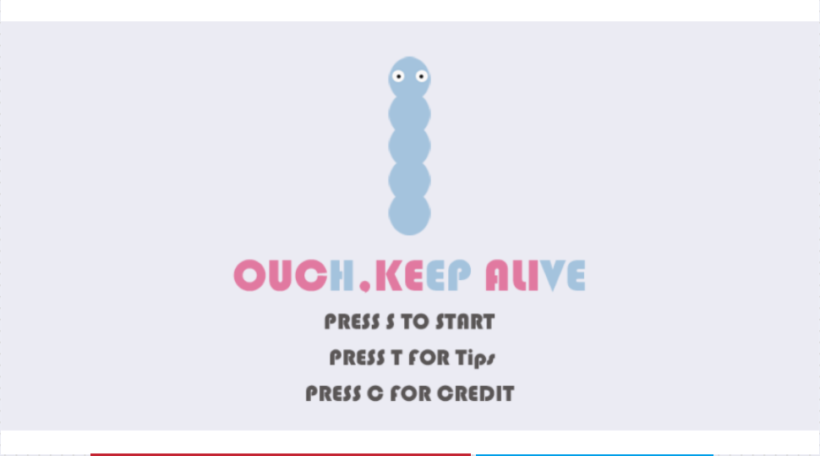
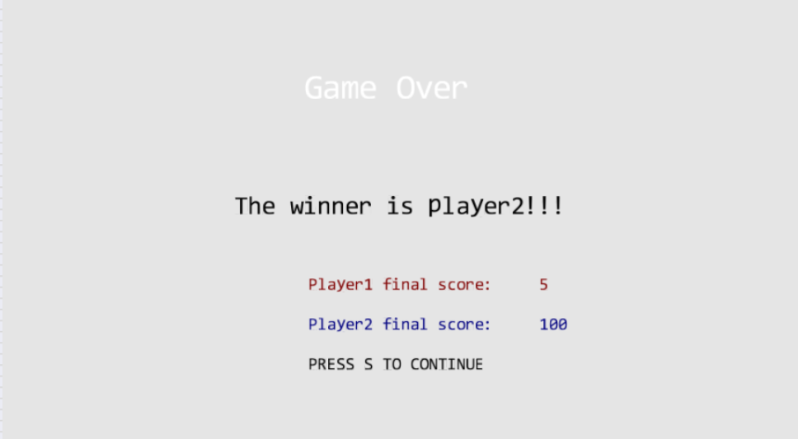
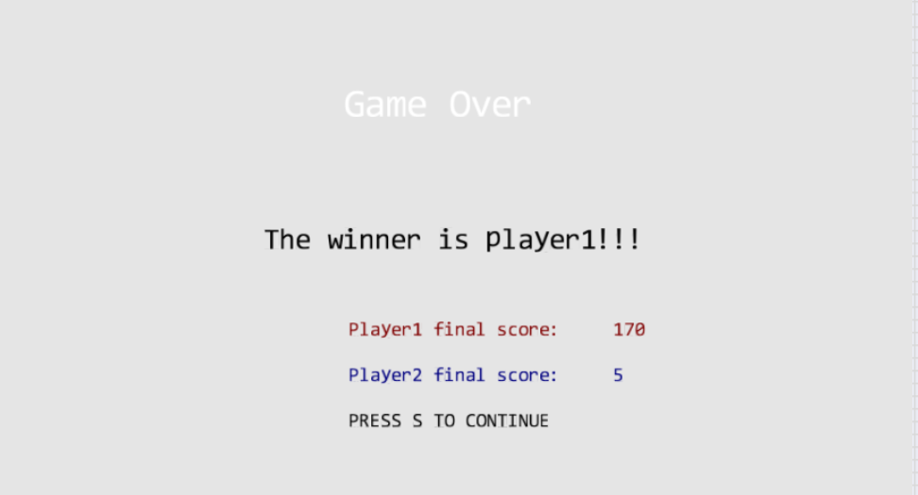
Supports 3 Scenes:
Flesh
Player2 win
Player1win

Slide 3



Appropriate game complexity
At least three object types
At least 10 instances

Slide 4
At least 2 camera views
Meaningful use of the cameras
Camera 1
Camera 2
Camera 3

Slide 5
Object Behavior
Move automatically
Crash(itself)
Against the wall

Slide 6

Ouch,Keep Alive
Ouch,Keep Alive
Old game, New Feeling
Now for you!

